Slide 1
Autonomous Robots
Robot Path Planning (3)

Slide 2
Global vs. Local Path Planning
Global Path planning
The path planner computes the complete path before providing a solution
Local Path planning
The path planner only provides the next step on a possible path.
No complete path is calculated prior to initiation of robot movement.
Roadmap and Cell Decomposition are global
Notes:
This is just for a small recap of the material covered in the previous class

Slide 3
Global Path Planning
Advantages:
It is generally known a priori if the goal will be reached or not
Simple to determine when the goal is unreachable
Disadvantages:
If the robot deviates from the path (due to slippage or similar uncertainties), the complete path calculation has to be redone.
No movement of the robot is possible prior to the completion of the complete path calculation
Notes:
This is just for a small recap of the material covered in the previous class

Slide 4
Autonomous Robots
Robot Path Planning:
Potential Field Approaches
Notes:
Next type of path planners:
One of the main motivations for these is to further reduce the complexity of path planning and avoid the problems of constructing complex road networks in higher dimensional spaces.

Slide 5
Potential Field Approaches
Construct a function, U(q), over the workspace, Q = {q}, of the robot that has large values at obstacle locations and small values at goal locations.
Potential function defines a surface on which the robot can move downhill, away from obstacles and towards goals
Compute the negative gradient, F(q) = -∇U(q), of the potential function at the robot’s location and move the robot in the corresponding direction.
Notes:
Analogy either to rubber sheet or drifting on water current,

Slide 6
Potential Field Approaches
Potential field approaches are local path planning techniques
At each point in time only the next step of the path is known.
Properties of the path depend on the characteristics of the potential function U(q)
Notes:
Analogy either to rubber sheet or drifting on water current,

Slide 7
Constructing Potentials
Potential functions should be such that goals are attractive (i.e. the potential should decrease towards the goal(s) )
Potential functions should be such that obstacles are repulsive (i.e. the potential should increase towards the obstacle(s) )
Notes:
Analogy either to rubber sheet or drifting on water current,

Slide 8
Mixture of Goal and Obstacle Potentials
Potential functions should be such that goals are attractive (i.e. the potential should decrease towards the goal(s) )
Potential functions should be such that obstacles are repulsive (i.e. the potential should increase towards the obstacle(s) )
Notes:
Analogy either to rubber sheet or drifting on water current,

Slide 9
Mixture of Goal and Obstacle Potentials
Attractive potential
Applied to all goal locations
U_{att}(q) = ½ ξ gdist(q) = ½ ξ |q – q_{goal}|²
F(q) = ξ |q_{goal} – q|
Repulsive potential
Applied to obstacles closer than dist₀
U_{rep}(q) =½ η (1/odist(q)–1/dist₀) ² for odist(q)<dist₀
F(q) = η (1/odist(q)–1/dist₀) 1/odist(q)² ∇odist(q)
Notes:
Analogy either to rubber sheet or drifting on water current,

Slide 10
Mixture of Goal and Obstacle Potentials
Resulting Path
Combined Potential
Obstacle potential
Goal potential

Slide 11
Mixture of Goal and Obstacle Potentials
Local Minima
There are situations where this potential field-based path planner gets stuck
Notes:
Analogy either to rubber sheet or drifting on water current,

Slide 12
Mixture of Goal and Obstacle Potentials
Advantages:
Very easy to construct
Provides direct commands for movement direction
Adjusts immideatley to deviations from the path
Does not require discretization of the workspace
Can be computed locally at run-time
Disadvantages:
Not complete (local minima)
Only correct if repulsive potential is chosen such that it is infinite at obstacles
Notes:
Analogy either to rubber sheet or drifting on water current,

Slide 13
Navigation Functions
Navigation functions are a class of potential functions which fulfill a number of constraints
Goals are minima
Obstacles are maxima
There are no local extrema besides goals and obstacles
Navigation functions form complete and correct path planners
Notes:
Analogy either to rubber sheet or drifting on water current,

Slide 14
Global vs. Local Potentials
Local potentials
Can be computed by only considering the local obstacle neighborhood
Previous potential approach was local (only distance to obstacles within given range)
Global potentials
Take into account entrie obstacle geometry
Most navigation functions are global
Can often only be computed on a discretized respresentation of the workspace
Notes:
Analogy either to rubber sheet or drifting on water current,

Slide 15
Navigation Functions
Manhattan distance on a regular grid forms a simple navigation function
Distance along the path can not have local extrema except at the goals (dist = 0) and at obstacles (dist = ∞)
Gradient always points to a cell with a potential that is 1 smaller than the current one.
Notes:
Analogy either to rubber sheet or drifting on water current,

Slide 16
Manhattan Distance
Discretize space into a regular grid
Propagate increasing distances to neighboring cells
Label goal cells with a potential of 0
21
20
19
18
17
16
15
14
13
12
11
10
9
8
7
6
7
22
21
20
13
12
11
10
9
8
7
6
5
6
23
22
21
22
13
12
11
4
5
22
21
20
14
13
3
4
21
20
19
13
12
2
3
20
19
18
17
16
15
12
11
1
2
19
18
17
16
15
14
13
12
11
10
9
2
1
0
1
18
17
16
15
14
13
12
11
10
9
8
4
3
2
1
2
17
16
15
14
13
12
11
10
9
8
7
6
5
4
3
2
3

Slide 17
Manhattan Distance Potential
Advantages:
Easy to compute
Complete to the resolution of the grid (i.e. if the path is at least 2√2 cells wide)
All paths are correct
Optimal in terms of Manhattan distance
Disadvantages:
Paths are not unique and contain many turns
Often path is select to minimizing the number of turns
Paths move arbitrarily close to obstacles
Notes:
Analogy either to rubber sheet or drifting on water current,

Slide 18
Harmonic Functions
Harmonic functions are functions with the property that the sum of second derivatives (curvature) is always 0 ( Σ∇²U(q) = 0 )
No local extrema except for platoes (if the potential increases in one direction then there has to be another direction in which it decreases)
Describe natural flow phenomena
Deformation of a rubber sheet when goal is pulled down and obstacles are raised
Flow of liquid
Notes:
Analogy either to rubber sheet or drifting on water current,

Slide 19
Harmonic Functions
Harmonic function can not be computed analytically but rather has to be determined using relaxation
Discretize the workspace into a regular grid
Fix the potential for goal cells at U(q) = 0.0 and for obstacle cells at U(q) = 1.0
Iterate over all cells, updating value according to
U(q) = U(q) + α (1/k Σ_{q’ neighbor of q} U(q’) – U(q)), k = |q’|,
α ≥ 1.0 (too large a number will make the relaxation fail)
Notes:
Analogy either to rubber sheet or drifting on water current,

Slide 20
Harmonic Potential
Advantages:
Complete to the resolution of the grid (i.e. if the path is at least 2√2 cells wide)
All paths are correct
Optimal in terms of the likelihood to collide with an object when deviating randomly from the path
Smooth paths when using interpolation
Disadvantages:
More complex to compute
Paths move arbitrarily close to obstacles
Notes:
Analogy either to rubber sheet or drifting on water current,

Slide 21
Potential Function Path Planning
Advantages:
Does not require replanning to address deviations from the path
Easier to expand to higher dimensional configuration spaces than roadmap approaches
When using navigation functions, the availability of a path is known before movement starts
Disadvantages:
Simple local potentials often have local extrema
Navigation functions are often more complex
Notes:
Analogy either to rubber sheet or drifting on water current,

Slide 22
Autonomous Robots
Robot Path Planning:
Non-Holonomic Path Planning
Notes:
Next type of path planners:
One of the main motivations for these is to further reduce the complexity of path planning and avoid the problems of constructing complex road networks in higher dimensional spaces.

Slide 23
Non-Holonomic Path Planning
Non-holonomic robots impose additional constraints on the path and thus do not fall into the basic path planning problem
Unicycle style robot can only move forward and turn (but not move sideways)
Bicycle type robot can only move along an arc)
Notes:
Analogy either to rubber sheet or drifting on water current,

Slide 24
Potential-Field Path Planning for Non-Holonomic Robots
Path planning in the robot’s configuration space. Non-holonomic constraints are encoded into the potential function
Connectivity of discretized representation is changed to only allow connections for configurations that can be directly reached
Configurations that lead to collisions (either with obstacles or within the structure itself) are labeled obstacle cells
Notes:
Analogy either to rubber sheet or drifting on water current,

Slide 25
Unicycle Type Robot Using Manhattan Distance
3D configuration space (x,y,θ)
Workspace discretized along all 3 dimensions
Connectivity for Manhattan Distance only along movement direction and in orientation
Notes:
Analogy either to rubber sheet or drifting on water current,

Slide 26
Unicycle Type Robot Using Manhattan Distance
Connecivity reflect reachable locations in
Compute distance potential
Path explicitly includes turns
5
4
3
4
3
5
3
2
3
4
3
4
3
5
4
5
2
5
4
5
5
4
1
1
4
5
5
2
5
3
1
3
3
5
3
4
0
4
4
4
5
3
1
5
5
5
2
5
4
4
4
5
4
1
5
5
5
4
5
2
5
5
3
4
4
5
Notes:
Analogy either to rubber sheet or drifting on water current,

Slide 27
Unicycle Type Robot Using Manhattan Distance
3D configuration space (x,y,θ)
Fixed number of steering angles (full left, straight, full right)
Connectivity for Manhattan Distance only along along possible paths
Can derive paths that incorporate parallel parking
Notes:
Analogy either to rubber sheet or drifting on water current,

Slide 28
Non-Holonomic Path Planning
Advantages:
Explicitly takes into account the motion constraints of the robot
Ensure that paths are actually executable by the robot
Disadvantages:
Higher dimensional configuration space to represent constraints
More complex path planning
Notes:
Analogy either to rubber sheet or drifting on water current,

Slide 29
High-Dimensional Path Planning
The methods described become computationally intractable in high dimensional configuration spaces (e.g. for snake robots with 30 DOF)
Discretized representation is too memory intensive
Path calculations are too complex
Randomized Path Planning:
Randomly generate pieces of a path, evaluate them, and if they do not get you closer, discard them. Repeat until a path is found
Notes:
Analogy either to rubber sheet or drifting on water current,

Slide 30

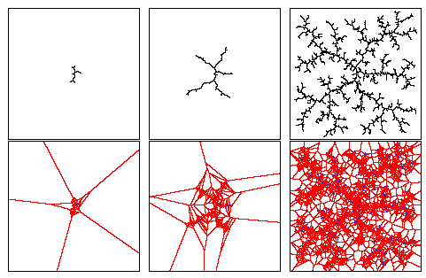
Rapidly Exploring Random Trees
Since exhaustive roadmap construction in high-dimensional configuration spaces is not possible, random road construction is used
Start node for new road segment is picked randomly according to the area of Cartesian space within which it is the nearest point
Road segment shape (action) is taken randomly according to its ability to decrease distance to goal
√
√
© Steve LaSalle & James Kuffner

Slide 31
Rapidly Exploring Random Trees
RRTs can cover large spaces (with high-dimensional configurations) very efficiently
Strength of the used heuristic regulates efficiency
Increased greediness results in faster search but with higher likelihood of not finding a roadmap with a path
Collision detection during road construction can incur significant additional cost if the space is dense with obstacles
For every road segment the configuration of the vehicle has to be considered along the entire segment
Efficiency can be increased by using bi-directional road construction

Slide 32

Rapidly Exploring Random Trees
© Dimitry Tifonov

Slide 33
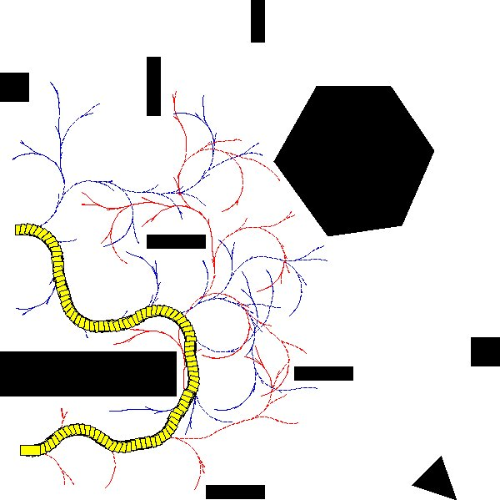
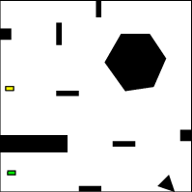
Rapidly Exploring Random Trees
Motion constraints are reflected in the road segments
Both kinematic and dynamic constraints can be encoded
Road segments are labeled with the actual control action
Path can be executed directly – RRT solves the trajectory planning problem not just path planning
© Steve LaSalle & James Kuffner

Slide 34
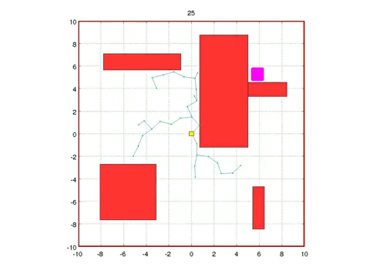
Rapidly Exploring Random Trees
First paths found tend to be inefficient
Randomized path refinement can improve quality
Path refinement generates random edges and nodes in the proximity of an existing “best” path
© Sertac Karaman

Slide 35
Rapidly Exploring Random Trees
RRTs allow to address very complex problems in high-dimensional configuration spaces
Road segment tree can be efficiently maintained
Randomized road generation makes it possible to solve arbitrary problems
RRTs can be used for arbitrary Robot platforms
RRTs trade off the quality of the found path against search and representation efficiency
On small, low-dimensional problems traditional path planning is often more effective

